Slide 1

Unidad 06
Aplicaciones Web
(ASP.Net)
[UTN - Tecnologías de desarrollo de software IDE]
[2009]
Notes:
Unidad Temática: 6
Eje Conceptual: Aplicaciones Web (ASP.Net) – Parte 2
Objetivo:
Conocer los fundamentos de una aplicación web y el modelo cliente/servidor utilizado en una arquitectura web. Implementar páginas web con ASP.NET, utilizar las clases y controles para agregar funcionalidad a las páginas web.
Conocer el funcionamiento de los eventos de página y controles web, manejo de estado comparando la diferentes maneras de conservarlos.
Conocer el concepto y aplicación de Master Pages, enlace de controles con datos, implementar y utilizar los diferentes controles que se encuentran incluidos con la plataforma relacionados a la navegación.
Implementar sistema de membrecía de usuarios incluido en la plataforma.
Temas:
Fundamentos de Internet.
Creación de formularios web.
Uso de server controls.
Implementación del code-behind.
Eventos en los web server controls.
Eventos de una página web.
Manejo de estado.
Variables de sesión y aplicación.
Master Pages.
Themes & Skins.
Acceso a datos y Databinding.
Controles complementarios (TreeView, Menu, y otros)
UserControls y CustomControls
Esquema de navegación del sitio.
Seguridad (Membership, Roles, Controles de Login, Profile).
Fuentes
MSDN
Programa MAS
CU.Net

Slide 2
Contenidos (parte 2)
Web Project System
Interfaz de Usuario (UI)
  Master Pages.
  Themes & Skins.
Acceso a datos y Databinding.
Controles Site Navigation: TreeView, Menu, SiteMap y otros.
UserControls y CustomControls
Seguridad: Membership, Roles, Controles de Login, Profile.

Slide 3
Web Project System
No depende de IIS para desarrollar
  Local Web Server incorporado
  IIS (Internet Information Services) es opcional
Acceso a Web Sites
  Local IIS
  File System
  FTP Site
  HTTP URL con FPE
Manejo flexible de archivos
  Permite leer estructura del Sistema de Archivos
Aplicaciones Web
Notes:
Manejo flexible de archivos: Al no haber archivo de proyecto, se lee la estructura directo del Sistema de Archivos (FileSystem)

Slide 4
Web Project System
Compilación on demand
  No requiere rehacer Build para ver cambios.
  Admite el estilo ASP (Save & Refresh)
Opciones de Despliegue (Deployment)
  Pre-compilar todo el sitio
  Deploy solo de de dll’s
  Separar en varios assemblies
  Soporte MSBuild (Build Automation via cmd)
    aspnet_compiler.exe
Aplicaciones Web

Slide 5
Interfaz de Usuario (UI)
Master Page
  “Herencia Visual" para páginas Web
Themes & Skins
  Cambiar el look’n feel de un site de la manera más facil e intuitiva
Aplicaciones Web
Notes:
[English]
ASP.NET 2.0 introduces a number of new features designed to help developers build cutting-edge UIs with a minimum of effort. First there's master pages, which enable pages to be templatized and which enjoy great design-time support in the Visual Studio 2005 IDE. Next, there's themes and skins, which allow controls, pages, and even entire sites to be visually themed with the stroke of a mouse.
Finally, ASP.NET 2.0 introduces about 50 new control types ranging from the simple (e.g., BulletedList and ImageMap) to the sublime (e.g., GridView, DetailsView, Menu, TreeView, and Wizard).

Slide 6
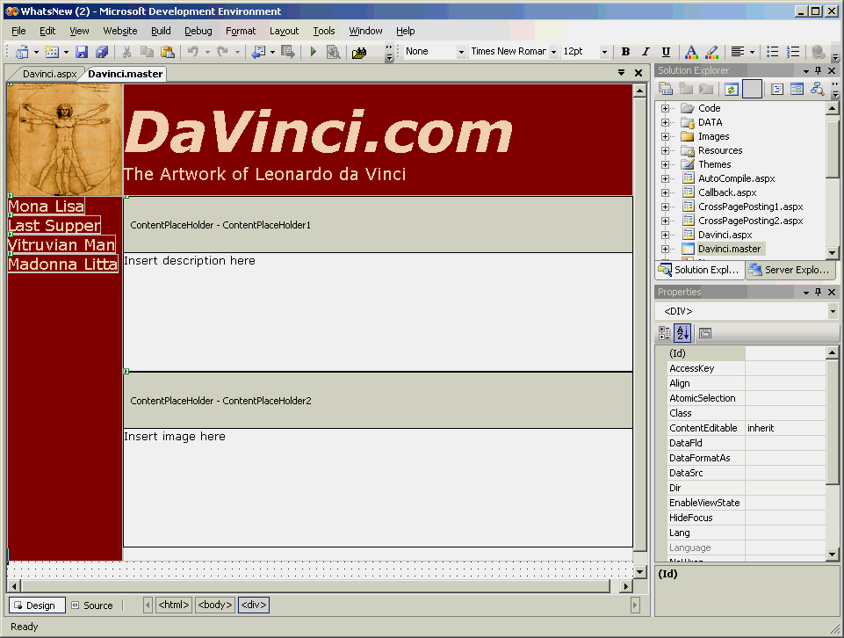
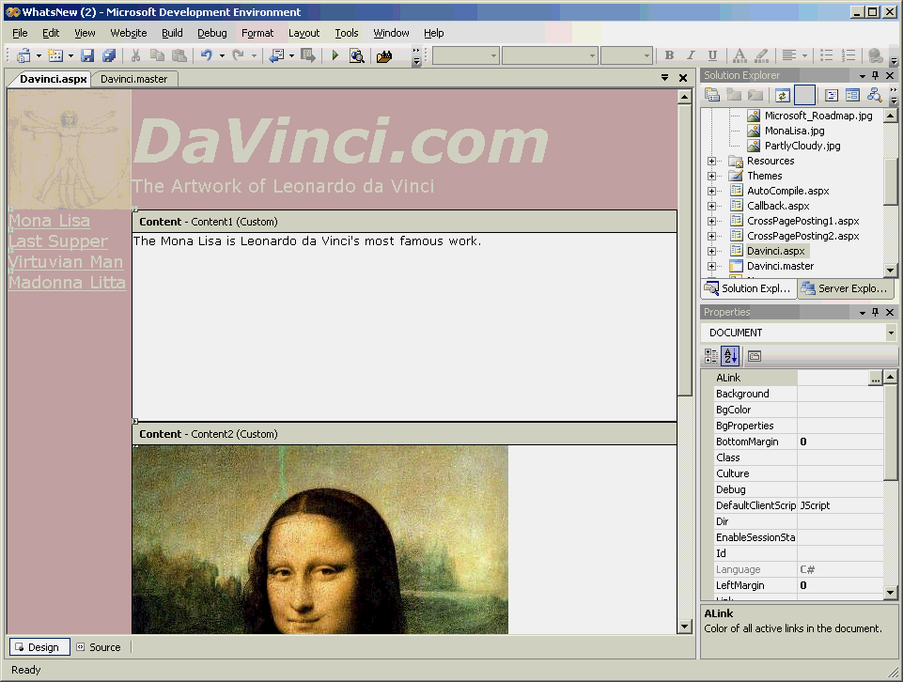
Master Page
Master Page
Content Page
Aplicaciones Web
Notes:
[English]
On the left is a master page as seen in the Visual Studio 2005 IDE. On the right is a content page that uses that master page, also shown in Visual Studio.
Note the rich design-time exeprience: when the content page is open in the designer, content declared in the page itself is shown in full color, while content inherited from the master page is shown in half-color.
Master pages enable developers to build templates that contribute code and content to other pages ("content pages") on the site. Because ASP.NET 1.x lacked template support, developers often resorted to factoring common UI elements--elements that appear on multiple pages--into user controls and then declaring the user controls in each page that uses them. Master pages provide a more elegant solution to the problem of defining common look and feel.
The term "visual inheritance" is often used to describe master pages because content pages inherit appearance from master pages the same way derived classes inherit methods, properties, and other type members from base classes.

Slide 7
Master Page
Masters definen <asp:ContentPlaceHolder>
Paginas definen <asp:Content>
Site.master
default.aspx
http://.../default.aspx
<%@ Master %>
<asp:ContentPlaceHolder
ID="Main"
RunAt="server" />
<%@ Page MasterPage-
File="Site.master" %>
<asp:Content
ContentPlaceHolderID=
"Main" RunAt="server" />
</asp:Content>
Aplicaciones Web
Notes:
[English]
The first and most important concept to grasp when learning about master pages is that of Content and ContentPlaceHolder controls. Master pages use ContentPlaceHolder controls to define where content pages can plug in content.
Content pages plug in content by declaring Content controls whose ContentPlaceHolderID properties match ContentPlaceHolder IDs in the master. A master page can contain an unlimited number of ContentPlaceHolder controls.
All content defined in content pages MUST appear in Content controls--that is, between <asp:Content> and </asp:Content> tags.

Slide 8
Master Page: definición
<%@ Master %>
<html>
<body>
<!-- Banner shown on all pages that use this master -->
<table width="100%">
<tr>
<td bgcolor="darkblue" align="center">
<span style="font-size: 36pt; color: white">ACME Inc.</span>
</td>
</tr>
</table>
<!-- Placeholder for content below banner -->
<asp:ContentPlaceHolder ID="Main" RunAt="server" />
</body>
</html>
Aplicaciones Web
Notes:
[English]
The @ Master directive at the top identifies this file as a master page file. Master pages MUST have the file name extension .master.

Slide 9
Master Page: aplicación
Aplicada a todo el sitio
Aplicada por Código
<configuration>
<system.web>
<pages masterPageFile="~/Site.master" />
</system.web>
</configuration>
void Page_PreInit (Object sender, EventArgs e)
{
Page.MasterPageFile = "~/Site.master";
}
Aplicaciones Web
Notes:
[English]
The benefit to designating master pages in Web.config is that it ensures that no page will be without a master--even pages that lack @ Page MasterPageFile directives. Masters designated with @ Page MasterPageFile directives in ASPX files override masters designated in Web.config.
PreInit is a new Page event that precedes Init events. It's the first event fired during a page's life cycle, and it's the correct place to programmatically designate master pages since master pages must be applied very early in a page's lifetime. Another use for PreInit events is to programmatically apply themes and skins.

Slide 10
Propiedad Page.Master
Como accedemos a la clase Master desde la página aspx?
  Page.Master
Utilizado para establecer propiedades de la Master desde la página.
Aplicaciones Web
Notes:
[English]
In practice, master pages often include controls that need to be accessed at run-time by content pages. In ASP.NET 2.0, the System.Web.UI.Page class includes a new property named Master that contains a reference to a content page's master page (or null if the page isn't assigned a master page). This enables controls defined in master pages to be supported by code contained in content pages. Of course, master pages can also include code that interacts with controls declared in master pages.

Slide 11
Referenciar una Master Page
En la master page…
En la pagina aspx…
<asp:Label ID="Title" RunAt="server" />
...
<script language="C#" runat="server">
public string TitleText
{
get { return Title.Text; }
set { Title.Text = value; }
}
</script>
Aplicaciones Web
Master.TitleText = "Orders";
Notes:
[English]
Rather than force a content page to use FindControl or walk the master page's control tree to retrieve a control reference, a master page can use public properties to expose controls to content pages. This provides the benefit of strong typing and simplifies the content pages' code. This example is functionally equivalent to the example on the previous slide.

Slide 12
Themes & Skins
Que es un Theme?
  Un conjunto de Skins
Que es un Skin?
  Conjunto de atributos visuales para uno o más controles
  OJO! No reemplaza al CSS sino que trabaja en conjunto
Aplicaciones Web
Notes:
[English]
In ASP.NET 1.x, properties that drive the appearance of controls have to be applied one at a time. Themes and skins allow visual properties to be grouped together and applied as a whole, to one control or several controls (even to entire pages and sites). A good analogue is Windows XP themes, which allow users to change the look of the desktop and of the "chrome" decorating windows with the flick of a switch. Unfortunately, ASP.NET 2.0 will ship without any built-in themes. The "BasicBlue" theme used in the following examples is a slightly modified copy of the theme of the same name included in pre-beta builds of ASP.NET.

Slide 13
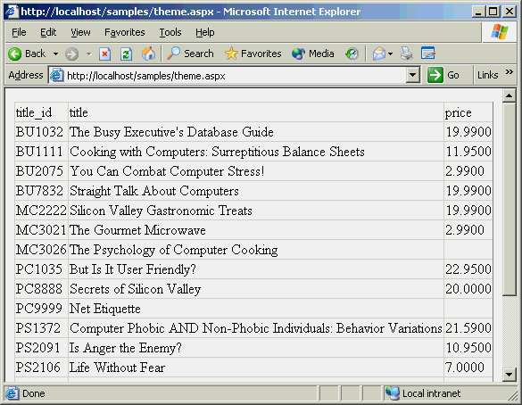
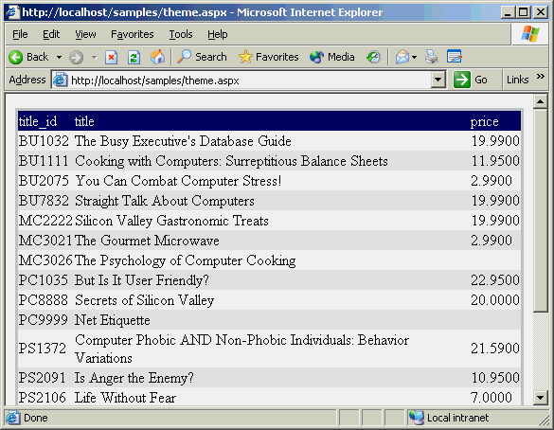
Themes & Skins
<%@ Page Theme="BasicBlue">
Antes
Después
Aplicaciones Web
Notes:
[English]
The @ Page directive's new Theme attribute enables a theme to be applied to all the controls on a page.

Slide 14
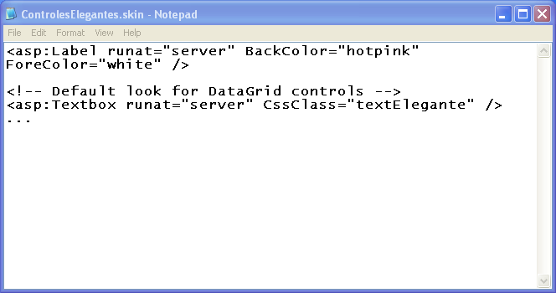
Skin: definición
Aplicaciones Web
Notes:
[English]
Themes are collections of skins. Skins are <asp:> tags defining default values for control properties. Skins are physically contained in .skin files. A .skin file can define property values for one control or many controls. Shown here is an excerpt from a .skin file.

Slide 15
Definiendo un Theme
WebSite
Nombre del Tema =
Nombre del Subdirectorio
App_Themes
Elegante
SKIN
ControlesEleg
antes.skin
Aplicaciones Web
Modernoso
SKIN
SKIN
Notes:
[English]
Local themes are private to individual applications and are stored in subdirectories under the application root's Themes directory.

Slide 16
Aplicando un Theme
Aplicado a una página
Aplicado a una página por código
Aplicado a todo el sitio
<%@ Page Theme=“Elegante” @%>
void Page_PreInit (Object sender, EventArgs e)
{
Page.Theme = “Elegante";
}
<configuration>
<system.web>
<pages theme=“Elegante" />
</system.web>
</configuration>
Aplicaciones Web
Notes:
[English]
You can apply a theme to ALL the pages on a site by applying it in Web.config. Themes applied in Web.config can be overridden with <%@ Page Theme="…" %> directives in individual pages. Also, you can theme different sections of a site differently by segregating the pages into subdirectories and including Web.config files like this one in the individual subdirectories.
PreInit is a new Page event that precedes Init events. PreInit is the correct place to programmatically apply themes to a page and to programmatically designate master pages. It is the first event fired during a page's life cycle.

Slide 17
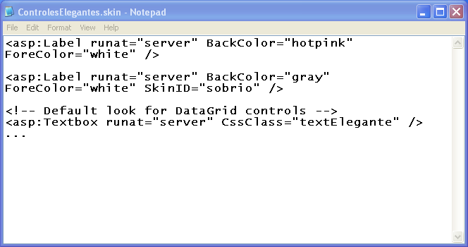
SkinID
Skin por Default
Skin “Sobrio”
Aplicaciones Web
Notes:
[English]

Slide 18
Laboratorio
Laboratorio Master Page

Slide 19
Acceso a datos y Databinding
Controles para el manejo del DataSource
  SqlDataSource
  ObjectDataSource
  XmlDataSource
Controles de Presentación de los Datos
  GridView : Datos tabulados con Paging y Sorting
  DetailsView: Detalle de datos
  FormView: Formulario
  DataList: Datos tabulados
  Repeater: Mas control sobre el formato
Aplicaciones Web
Notes:
[English]

Slide 20
Web.config
Repositorio central de configuración de la aplicación Web
Definición de settings personaliados
Configuración de Autorización y Autenticación
Aplicaciones Web
Notes:
El web.config sirve para configurar la aplicación ASP.NET o parte de ella.
Puede existir un web.config en cada carpeta de la aplicación y configurará opciones para todas las subcarpetas de la misma, a menos que exista un web.config que en alguna de ellas, que sobrescriba los valores definidos por el web.config exterior.
Normalmente se tiene un web.config en el root del site ASP.NET.
En el web.config de definen los roles de acceso, membresías, conexión a base de datos y las variables propias de la aplicación entre otras configuraciones.
En tiempo de ejecución se pueden obtener los valores aquí definidos, mediante las clases que forman parte de la librería del Framework y se encuentran en el namespace System.Configuration.

Slide 21
SqlDataSource
<asp:SqlDataSource
  ID="ProductsSqlDataSource“
  runat="server“
  ConnectionString="<%$ ConnectionStrings:Northwind %>"
SelectCommand="SELECT ProductID,Name">
</asp:SqlDataSource>
<asp:DataGrid
DataSourceID="ProductsObjectDataSource“
RunAt="server" />
Aplicaciones Web
Notes:
[English]
This code snippet demonstrates canonical ASP.NET 2.0 data binding. Thanks to SqlDataSource's ability to query a data source and bind to a control, no code is required. In addition to querying databases, SqlDataSource can also update databases. It isn't restricted to SQL Server databases; it can talk to any database for which a managed provider is available. SqlDataSource is part of a new family of data source controls. Another notable member of that family is ObjectDataSource, which enables controls to declaratively data-bind to middle-tier data access components.
In case anyone asks, yes, SqlDataSource can call stored procedures and use parameterized queries, and no, connection strings do NOT have to be stored in ASPX files or in plaintext. A new declarative syntax permits the control's ConnectionString property to reference a connection string in the new <connectionStrings> section of Web.config, and the entire <connectionStrings> section (as well as other sections of Web.config) can optionally be encrypted. All this and more will be covered in the data access course module.
In this example (and others in this deck), the connection string is hard-coded into the ASPX file. In practice, you should put connection strings in the <connectionStrings> section of Web.config instead and load them with $ expressions. Among other things, putting connection strings in Web.config gives you the option of encrypting them.

Slide 22
SqlDataSource: propiedades
Propiedades del SqlDataSource
Nombre
Descripción
ConnectionString
Identifica la base de datos a conectarse
SelectCommand
Comando utilizado para efectuar consultas
InsertCommand
Comando utilizado para realizar inserts
UpdateCommand
Comando utilizado para realizar actualizaciones
Aplicaciones Web
DeleteCommand
Comando utilizado para efectuar cancelaciones
DataSourceMode
Especifica si el DataSet o el DataReader es utilizado
(default = DataSet)
ProviderName
Especifica el Proveedor (default = Proveedor SQL Server .NET)
Notes:
[English]
SqlDataSource implements LOTS of public properties. These are some of the ones that developers are most likely to use, and ones that unlock some of SqlDataSource's key features. In particular, SelectCommand defines the query that a SqlDataSource uses to fetch data from a database, while InsertCommand, UpdateCommand, and DeleteCommand define the commands it uses to update the database when 2-way data binding is performed. InsertCommand, UpdateCommand, and DeleteCommand are discussed in detail later in this lecture.

Slide 23
SqlDataSource: pasar parámetros
Como pasar parámetros a:
  Un Procedimiento Almacenado (Stored Procedure) o a una consulta (Query)
Nombre
Descripción
SelectParameters
Especifica los parámetros para SelectCommand
InsertParameters
Especifica los parámetros para InsertCommand
UpdateParameters
Especifica los parámetros para UpdateCommand
DeleteParameters
Especifica los parámetros para DeleteCommand
Aplicaciones Web
FilterParameters
Especifica los parámetros para FilterExpression
Notes:
[English]
Data source controls would have limited value if SelectCommand, InsertCommand, UpdateCommand, and DeleteCommand could not be parameterized. A great example is the case where data displayed in a GridView is keyed to the value currently selected in a DropDownList. In that case, the SqlDataSource serving the GridView needs a SelectCommand containing a WHERE clause with a replaceable parameter whose value comes from the DropDownList. Fortunately, this scenario is supported, meaning SqlDataSource controls can perform SELECTs, INSERTs, UPDATEs, and DELETEs of arbitrary complexity.
The SelectParameters, InsertParameters, UpdateParameters, and DeleteParameters properties provide a handy mechanism for declaratively adding parameters to a SqlDataSource's SelectCommand, InsertCommand, UpdateCommand, and DeleteCommand. FilterParameters defines parameters for SqlDataSource.FilterExpression. FilterExpression filters the data returned by SelectCommand. On the surface, it might seem as if defining a FilterExpression is no different than including a WHERE clause in a SelectCommand. However, FilterExpression works even if the SqlDataSource is caching query results.

Slide 24
SqlDataSource
<asp:SqlDataSource ID="Countries" RunAt="server"
ConnectionString="server=localhost;database=northwind;..."
SelectCommand="select distinct country from customers order by country" />
<asp:SqlDataSource ID="Customers" RunAt="server"
ConnectionString="server=localhost;database=northwind;..."
SelectCommand="select * from customers where country=@Country">
<SelectParameters>
<asp:ControlParameter Name="Country" ControlID="MyDropDownList"
PropertyName="SelectedValue" />
</SelectParameters>
</asp:SqlDataSource>
<asp:DropDownList ID="MyDropDownList" DataSourceID="Countries"
DataTextField="country" AutoPostBack="true" RunAt="server" />
<asp:DataGrid DataSourceID="Customers" RunAt="server" />
Aplicaciones Web
Notes:
[English]
This example uses the value of the item currently selected in a drop-down list to fill a parameter in a SELECT statement's WHERE clause. Note the <SelectParameters> element adding parameters to SelectCommand, and the <asp:ControlParameter> element corresponding to the @Country parameter in the SelectCommand. If SelectCommand contained additional parameters, <SelectParameters> would contain additional <asp:XxxParameter> elements.
A common question regarding SqlDataSource controls is "Can they call stored procedures?" The answer is yes.
Both the SelectCommands could be replaced by a SP. One of the stored procedures used has no parameters. The other has a SELECT parameter, so a <SelectParameters> element is used to tie the value of that parameter to the item selected in a drop-down list. This functionally is equivalent with or without SP.

Slide 25
XmlDataSource
<asp:XmlDataSource ID="Rates" DataFile="Rates.xml"
runat="server"/>
<asp:TreeView ID="MyTreeView" DataSourceID="Rates"
runat="server"/>
Aplicaciones Web
Notes:
[English]
XmlDataSource is functionally similar to SqlDataSource, but it's designed to read data from XML data sources rather than databases. One use for XmlDataSource is to read hierarchical data from an XML file and then render that data using a TreeView control, as shown here.

Slide 26
ObjectDataSource
<asp:ObjectDataSource
ID="ProductsObjectDataSource"
runat="server"
SelectMethod="GetAllProducts" TypeName=“Model.Products“ />
<asp:DataGrid DataSourceID="ProductsObjectDataSource“ runat="server" />
Aplicaciones Web
Notes:
[English]
This code snippet demonstrates canonical ASP.NET 2.0 data binding. Thanks to SqlDataSource's ability to query a data source and bind to a control, no code is required. In addition to querying databases, SqlDataSource can also update databases. It isn't restricted to SQL Server databases; it can talk to any database for which a managed provider is available. SqlDataSource is part of a new family of data source controls. Another notable member of that family is ObjectDataSource, which enables controls to declaratively data-bind to middle-tier data access components.
In case anyone asks, yes, SqlDataSource can call stored procedures and use parameterized queries, and no, connection strings do NOT have to be stored in ASPX files or in plaintext. A new declarative syntax permits the control's ConnectionString property to reference a connection string in the new <connectionStrings> section of Web.config, and the entire <connectionStrings> section (as well as other sections of Web.config) can optionally be encrypted. All this and more will be covered in the data access course module.
In this example (and others in this deck), the connection string is hard-coded into the ASPX file. In practice, you should put connection strings in the <connectionStrings> section of Web.config instead and load them with $ expressions. Among other things, putting connection strings in Web.config gives you the option of encrypting them.

Slide 27
Control GridView
Presenta los datos de un DataSource
Cero-codigo
  Creacion, Edición, Borrado, Seleccion, Paginado y Ordenado
Altamente customizable
Aplicaciones Web
Notes:
[English]
GridView is best described as a super DataGrid: it does everything DataGrid does and then some. Unlike the DataGrid, which requires code to do sorting, paging, selecting, and editing, the GridView control can perform all these actions innately--that is, with no code. GridView also supports a richer assortment of column types than DataGrid. The ImageField column type, for example, enables GridViews to display images--something the DataGrid requires help to do.

Slide 28
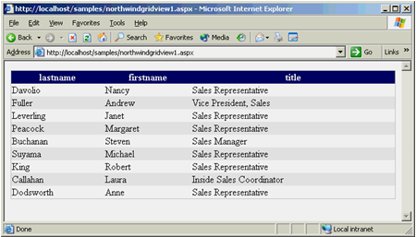
GridView
<asp:SqlDataSource ID="Employees“ RunAt="server" ConnectionString="server=localhost; database=northwind;..."
SelectCommand=“Select lastname, firstname, title from employees" />
<asp:GridView DataSourceID="Employees"
RunAt="server"
Width="100%" />
Aplicaciones Web
Notes:
[English]
This example uses a GridView and a SqlDataSource to display data from the Employees table of SQL Server's Northwind database. To dress up the output just a little, use an <%@ Page Theme="BasicBlue" %> directive to add color to the GridView.

Slide 29
GridView
Tipos de columnas
Nombre
Descripción
BoundField
Renderea columnas de texto de campos en data source
ButtonField
Renderea columna de botones (push button, image, or link)
CheckBoxField
Renderea Booleanos como check boxes
CommandField
Renderea controles para seleccionar y editar datos de GridView
HyperLinkField
Renderea columnas de hyperlinks
ImageField
Renderea columnas de imagenes
Aplicaciones Web
TemplateField
Renderea columnas usando plantillas HTML
Notes:
[English]
GridView field types are analogous to DataGrid column types. CheckBoxField and ImageField are especially significant because there are no equivalent DataGrid column types.

Slide 30
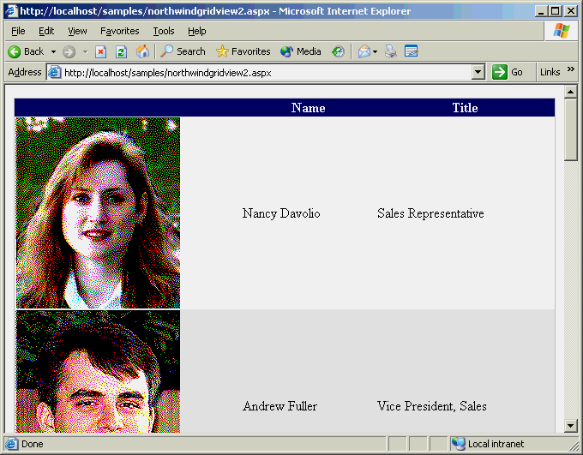
GridView
<asp:SqlDataSource ID="Employees" RunAt="server"
ConnectionString="server=localhost;database=northwind;..."
SelectCommand="select photo, lastname, firstname, title from employees" />
<asp:GridView DataSourceID="Employees" Width="100%" RunAt="server"
AutoGenerateColumns="false" >
<Columns>
<asp:ImageField HeaderText="" DataField="photo" />
<asp:TemplateField HeaderText="Name">
<ItemTemplate>
<%# Eval("firstname") +
" " + Eval("lastname") %>
</ItemTemplate>
</asp:TemplateField>
<asp:BoundField
HeaderText="Title"
DataField="title" />
</Columns>
</asp:GridView>
Aplicaciones Web
Notes:
[English]
Just as DataGrids can be customized by setting AutoGenerateColumns="false" and declaring columns in a <Columns> element, GridViews can be customized by setting AutoGenerateColumns="false" and declaring fields in a <Columns> element. This example uses an ImageField column to display employee photos obtained from Northwind's Employees table, a TemplateField to combine first names and last names, and a BoundField to display the contents of each record's "Title" field.
Note that the employee photos required no code to display. The same would not be true had a DataGrid been used instead.

Slide 31
DetailsView
Vista detalle del master-detail
  Se puede utilizar junto al GridView
  Se puede utilizar sola
Columnas
  Se definen de igual manera que en GridView
Aplicaciones Web
Notes:
[English]
Whereas GridView is designed to render sets of records into HTML tables, DetailsView is designed to take one record or a set of records and display them one at a time. Built-in paging support enables records bound to a DetailsView to be browsed with no code. Built-in editing support allows records to be inserted, updated, and deleted, again with no code (although the reality is that you'll end up writing some code to handle concurrency issues and respond to update failures). The same field types--ImageField, CheckBoxField, and so on--that can be declared in a GridView can also be declared in a DetailsView. In demonstrations, DetailsView controls are often paired with GridView controls to implement master-detail views. However, DetailsView is perfectly capable of working without GridView.

Slide 32
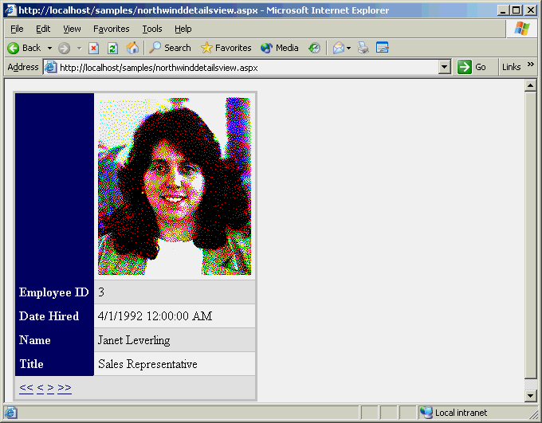
DetailsView
<asp:SqlDataSource ID="Employees" RunAt="server"
ConnectionString="..." SelectCommand="..." />
<asp:DetailsView DataSourceID="Employees" RunAt="server"
AllowPaging="true" AutoGenerateRows="false"
PagerSettings-Mode="NextPreviousFirstLast" >
<Fields>
<asp:ImageField HeaderText="" DataField="photo" />
<asp:BoundField HeaderText="Employee ID" DataField="employeeid"/>
<asp:BoundField HeaderText="Date Hired" DataField="hiredate"/>
<asp:TemplateField HeaderText="Name">
<ItemTemplate><%# Eval("firstname") + " " + Eval("lastname") %>
</ItemTemplate>
</asp:TemplateField>
<asp:BoundField HeaderText="Title"
DataField="title" />
</Fields>
</asp:DetailsView>
Aplicaciones Web
Notes:
[English]
This example declares a DetailsView control and uses a <Fields> element to declare the fields that the DetailsView displays. Like GridView, DetailsView automatically populates itself with fields if you leave AutoGenerateRows set to false (the default).
Once again, displaying employee photos requires no code. And once again, theming was used to colorize the control's output.
<asp:SqlDataSource ID="Employees" RunAt="server"
ConnectionString="server=localhost;database=northwind;..."
SelectCommand="select employeeid, photo, ... from employees" />
<asp:DetailsView DataSourceID="Employees" RunAt="server"
AllowPaging="true" AutoGenerateRows="false"
PagerSettings-Mode="NextPreviousFirstLast" >
<Fields>
<asp:ImageField HeaderText="" DataField="photo" />
<asp:BoundField HeaderText="Employee ID" DataField="employeeid"/>
<asp:BoundField HeaderText="Date Hired" DataField="hiredate"/>
<asp:TemplateField HeaderText="Name">
<ItemTemplate>
<%# Eval ("firstname") + " " + Eval ("lastname") %>
</ItemTemplate>
</asp:TemplateField>
<asp:BoundField HeaderText="Title" DataField="title" />
</Fields>
</asp:DetailsView>

Slide 33
Laboratorio
Laboratorio Grilla

Slide 34
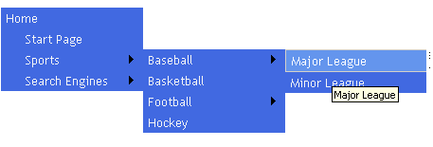
Menu

Slide 35
Menu
Menus Drop-down/fly-out para páginas Web
  Los Items son navegables y seleccionables
Pueden ser orientados:
  horizontalmente o
  verticalmente
El contenido es definido por objetos MenuItem
  Los MenuItems pueden ser agregados declarativamente, por código o a través de data binding

Slide 36
Site Navigation
Controles
Menu
TreeView
SiteMap-
DataSource
SiteMapPath
API de Navigación del Sitio
SiteMap
SiteMapNode
SiteMapNode
SiteMapNode
Proveedores
XmlSiteMapProvider
Otros proveedores de
mapa del sitio
Mapas del Sitio
Web.sitemap
Otro
almacenador
de datos
Notes:
Site navigation uses the layered architecture shown here. Controls such as Menu and TreeView provide the navigation UIs. Classes such as SiteMap and SiteMapNode provide the API that the controls rely on and also constitute an API you can use yourself if you wish. Site navigation is provider-based, and the one site map provider that comes with ASP.NET 2.0--XmlSiteMapProvider--reads site maps from XML data files. By default, those files are named Web.sitemap. In the providers lab, students write a custom site map provider that reads site maps from a SQL Server database.

Slide 37
Site Navigation
La navegación de UI compleja de implementar
  Especialmente si depende de un client-side script
Nuevos controles simplifican la navegación del sitio.
  Navegación UI: TreeView y Menu
  SiteMap en xml: SiteMapDataSource
  Bread crumb: SiteMapPath

Slide 38
SiteMapDataSource
<siteMap>
<siteMapNode url=“~/Default.aspx” title=“Home” roles=“” />
<siteMapNode url=“~/SomeDir/Default.aspx” title=“Info” roles=“”>
<siteMapNode url=“~/SomeDir/Info.aspx” title=“Home” />
</siteMapNode>
</siteMap>
Notes:
Rather than manually populate TreeViews and Menus that are used for site navigation with links, you can bind them to SiteMapDataSources. SiteMapDataSource controls use site map providers to read site maps. They then provide the site map data to the controls they're bound to. Binding a TreeView to a SiteMapDataSource transforms each node in the site map into a TreeView node; binding a Menu to a SiteMapSource transforms each node in the site map into a menu item. The only site map provider that comes with ASP.NET 2.0 is XmlSiteMapProvider. It enables site maps to be read from XML files that conform to a predefined schema.

Slide 39
TreeView
Ramas expandibles y plegables via javascript
Los nodos son navegables, seleccionables, o estáticos y pueden incluir check boxes
El contenido es definido por objetos TreeNode
  Los TreeNodes pueden ser agregados declarativamente, por código o a través de data binding
  Los TreeNodes también pueden ser cargados por demanda

Slide 40
Seguridad

Slide 41
Seguridad
API de Membership, Roles, Profile
Controles de Login, LoginStatus, etc.

Slide 42
Membership
FormsAuthentication en ASP.Net 1.1 solo nos daba la infrastructura de Cookies y navegación
Desde ASP.Net 2.0 nos permite una solución completa de Authentication
Basado en providers
  SqlMembershipProviders
Notes:
The Membership service dramatically reduces the amount of code required to implement forms authentication. In ASP.NET 1.x, you had to supply the code to validate and store credentials. In version 2.0, most of that is done for you. The provider model allows credentials to be stored in SQL Server databases or any other medium for which a membership provider is available.

Slide 43
Membership
Controles
Login
LoginStatus
LoginView
Other Login
Controls
Membrecía API
Membership
MembershipUser
Proveedores de Membrecía
AccessMembershipProvider
SqlMembershipProvider
Otros proveedores
de Membrecía
Datos de Membrecía
Access
SQL Server
Otro
almacenador
de datos
Notes:
This is one specific example of the provider model--the one used by the Membership service. The application talks to the Membership service through classes such as Membership and MembershipUser. These classes, in turn, read and write membership data by calling a provider. (Each class has a property named Provider that identifies the associated provider.) Each provider interfaces with a particular type of data store. If none of the providers supplied with the Framework supports the data store you wish to use (for example, an Oracle database), you can write a provider of your own or acquire one from a third party. The Membership service is one of several services that are provider-based.

Slide 44
Membership
La clase Membership es una façade con métodos static o Shared para las tareas:
  Crear y Borrar usuarios (CreateUser)
  Enumerar usuarios (GetAllUsers)
  Validar credenciales (ValidateUser)
  Generación de password al azar (GeneratePass)
Notes:
The Membership class is the gateway to the membership API. It provides static methods for performing key membership tasks such as creating and deleting users, enumerating users, and validating login credentials. Tasks that used to require tens or hundreds of lines of code can now often be accomplished with just one or two lines by invoking Membership methods.
All of these methods are static methods. The names are self-explanatory. Membership methods not shown here include FindUsersByEmail, FindUsersByName, GetNumberOfUsersOnline, and GetUserNameByEmail. GetNumberOfUsersOnline is interesting because it returns a count of the number of registered users who are currently logged in to your site. A user is considered to be "online" if he or she has submitted a request to the site in the past N minutes, where N is the userIsOnlineTimeWindow value in the <membership> configuration section:
<!-- Excerpt from Machine.config.comments -->
<membership defaultProvider="…" userIsOnlineTimeWindow="15">
...
</membership>
The default userIsOnlineTimeWindow value is 15 minutes.

Slide 45
Membership
CreateUser
try {
Membership.CreateUser ("Jeff", "imbatman", "jeff@microsoft.com");
}
catch (MembershipCreateUserException e) {
// Find out why CreateUser failed
switch (e.StatusCode) {
case MembershipCreateStatus.DuplicateUsername:
...
case MembershipCreateStatus.DuplicateEmail:
...
case MembershipCreateStatus.InvalidPassword:
...
default:
...
}
}
Notes:
The Membership class is the gateway to the membership API. It provides static methods for performing key membership tasks such as creating and deleting users, enumerating users, and validating login credentials. Tasks that used to require tens or hundreds of lines of code can now often be accomplished with just one or two lines by invoking Membership methods.
All of these methods are static methods. The names are self-explanatory. Membership methods not shown here include FindUsersByEmail, FindUsersByName, GetNumberOfUsersOnline, and GetUserNameByEmail. GetNumberOfUsersOnline is interesting because it returns a count of the number of registered users who are currently logged in to your site. A user is considered to be "online" if he or she has submitted a request to the site in the past N minutes, where N is the userIsOnlineTimeWindow value in the <membership> configuration section:
<!-- Excerpt from Machine.config.comments -->
<membership defaultProvider="…" userIsOnlineTimeWindow="15">
...
</membership>
The default userIsOnlineTimeWindow value is 15 minutes.

Slide 46
Membership
ValidateUser
if ( Membership.ValidateUser(UserName.Text, Password.Text)) {
// si el usuario es válido…
FormsAuthentication.RedirectFromLoginPage( UserName.Text, RememberMe.Checked);
}
Notes:
The Membership class is the gateway to the membership API. It provides static methods for performing key membership tasks such as creating and deleting users, enumerating users, and validating login credentials. Tasks that used to require tens or hundreds of lines of code can now often be accomplished with just one or two lines by invoking Membership methods.
All of these methods are static methods. The names are self-explanatory. Membership methods not shown here include FindUsersByEmail, FindUsersByName, GetNumberOfUsersOnline, and GetUserNameByEmail. GetNumberOfUsersOnline is interesting because it returns a count of the number of registered users who are currently logged in to your site. A user is considered to be "online" if he or she has submitted a request to the site in the past N minutes, where N is the userIsOnlineTimeWindow value in the <membership> configuration section:
<!-- Excerpt from Machine.config.comments -->
<membership defaultProvider="…" userIsOnlineTimeWindow="15">
...
</membership>
The default userIsOnlineTimeWindow value is 15 minutes.

Slide 47
MembershipUser
Representa un usuario
Posee propiedades:
  Comment, CreationDate, Email,
  LastLoginDate, LastPasswordChangedDate,
  UserId, UserName
Se obtiene mediante: GetUser o CreateUser
Notes:
The Membership class is the gateway to the membership API. It provides static methods for performing key membership tasks such as creating and deleting users, enumerating users, and validating login credentials. Tasks that used to require tens or hundreds of lines of code can now often be accomplished with just one or two lines by invoking Membership methods.
All of these methods are static methods. The names are self-explanatory. Membership methods not shown here include FindUsersByEmail, FindUsersByName, GetNumberOfUsersOnline, and GetUserNameByEmail. GetNumberOfUsersOnline is interesting because it returns a count of the number of registered users who are currently logged in to your site. A user is considered to be "online" if he or she has submitted a request to the site in the past N minutes, where N is the userIsOnlineTimeWindow value in the <membership> configuration section:
<!-- Excerpt from Machine.config.comments -->
<membership defaultProvider="…" userIsOnlineTimeWindow="15">
...
</membership>
The default userIsOnlineTimeWindow value is 15 minutes.

Slide 48
Membership Flexibilidad
Basada en Providers
Providers que vienen built-in
  SqlMembershipProvider – SQL Server
  ActiveDirectoryMembershipProvider – AD
Podemos hacer nuestro propio MembershipProvider
  Ejemplo: OracleMembershipProvider
Notes:
The Membership class is the gateway to the membership API. It provides static methods for performing key membership tasks such as creating and deleting users, enumerating users, and validating login credentials. Tasks that used to require tens or hundreds of lines of code can now often be accomplished with just one or two lines by invoking Membership methods.
All of these methods are static methods. The names are self-explanatory. Membership methods not shown here include FindUsersByEmail, FindUsersByName, GetNumberOfUsersOnline, and GetUserNameByEmail. GetNumberOfUsersOnline is interesting because it returns a count of the number of registered users who are currently logged in to your site. A user is considered to be "online" if he or she has submitted a request to the site in the past N minutes, where N is the userIsOnlineTimeWindow value in the <membership> configuration section:
<!-- Excerpt from Machine.config.comments -->
<membership defaultProvider="…" userIsOnlineTimeWindow="15">
...
</membership>
The default userIsOnlineTimeWindow value is 15 minutes.

Slide 49
Membership Configuración
<configuration>
<connectionStrings>
<add name="SqlServices" connectionString="Data Source=localhost;Integrated Security=SSPI;Initial Catalog=aspnetdb;" />
</connectionStrings>
<system.web>
<authentication mode="Forms" >
<forms loginUrl="login.aspx" name=".ASPXFORMSAUTH" />
</authentication>
<authorization>
<deny users="?" />
</authorization>
<membership defaultProvider="SqlProvider “userIsOnlineTimeWindow="15">
<providers>
<add
name="SqlProvider"
type="System.Web.Security.SqlMembershipProvider" connectionStringName="SqlServices"
applicationName="MyApplication“
enablePasswordRetrieval="true“
enablePasswordReset="true“
requiresQuestionAndAnswer="true"
requiresUniqueEmail="false“
passwordFormat="Encrypted" />
</providers>
</membership>
</system.web>
</configuration>

Slide 50
Roles
Analogo a Membership
Manejo de Roles de usuarios
CreateRole, DeleteRole, AddUsersToRole, FindUsersInRole, IsInRole, RoleExists
Providers built-in
  SqlRolesProvider (Sql Server)
  AuthorizationStoreRolesProvider (AzMan)
  WindowsTokenRolesProvider (Windows)

Slide 51
Controles de Login
UI estándar para logueo de usuarios
Integrado con el servicio de Membership
  Llama al ValidateUser automáticamente
Se puede utilizar sin el servicio de membrecía
Utiliza RequiredFieldValidators
Notes:
Combined with the Membership service, these new controls further reduce the amount of code required to implement forms authentication. They also promote a standard look and feel. Despite their high level of integration with the Membership service, these controls can also be used without it.
The Login control is the centerpiece of the login controls family. Its appearance and behavior are highly customizable because of the numerous properties it exposes, its support for layout templates, and the events that it fires. If you want to validate login credentials yourself rather than let the control do it, for example, you simply process the control's Authenticate event. Or, if you'd like to add RegularExpressionValidators to filter out invalid or potentially harmful user names and passwords, you can do so through layout templates.

Slide 52
Controles de Login
Control
Descripción
ChangePassword
UI para cambiar contraseñas
CreateUserWizard
UI para crear nuevas cuentas de usuarios
Login
UI para entrar y validar nombres de usuarios y contraseñas
LoginName
Muestra nombres de usuarios autentificados
LoginStatus
UI para conectarse y desconectarse
LoginView
Muestra diferentes vistas basadas en status de conexiones y roles
PasswordRecovery
UI para recuperar contraseñas olvidadas

Slide 53
Eventos de Login
Nombre
Descripción
Authenticate
Aparece cuando el usuario hace un clic en el botón de Log in.
Propósito: autenticar el usuario validando sus credenciales
LoggedIn
Aparece luego de la login exitoso
LoggingIn
Aparece cuando el usuario hace un clic en el botón de Log in.
Propósito: prevalidar las credenciales de conexión (ej. Asegurarse
que las casillas de e-mails esten bien creadas)
LoginError
Aparece cuando el Log in falla
Notes:
Login controls' behavior can be customized by processing one or more of these events. For example, if you want to validate login credentials yourself rather than have the control do it for you (a task it accomplishes by calling ValidateUser on the current membership provider), you can process the control's Authenticate event.

Slide 54
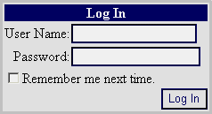
Usando el Control de Login
<html>
<body>
<form runat="server">
<asp:Login RunAt="server" />
</form>
</body>
</html>
Notes:
The snapshot shown here was taken on a page with a Theme="BasicBlue" attribute--hence the stylized appearance of the Login control.

Slide 55
Profile
Que es un perfil?
  Ej. Cantidad de filas por página
  Ej. Theme
ASP.Net provee un mecanismo para almacenar datos del perfil del usuario
  Es distinto a la sesión
  Almacenamiento permanente
  Soporta usuarios anónimos y autenticados
Basado en providers
  SqlProfileProvider
Notes:
On the surface, the profile service sounds a lot like session state since both are designed to store per-user data. However, profiles and session state differ in significant ways. Profiles should not be construed as a replacement for session state, but rather as a complement to it. For applications that store shopping carts and other per-user data for a finite period of time, session state is still a viable option.

Slide 56
Esquema de Profile
Perfiles
HttpProfileBase
HttpProfile (Autogenerated
HttpProfileBase-Derivative)
HttpProfile (Autogenerated
HttpProfileBase-Derivative)
Proveedores de Perfiles
AccessProfileProvider
SqlProfileProvider
Otros proveedores
de perfiles
Almacenamiento de Datos de perfiles
Access
SQL Server
Otras fuentes
de datos
Notes:
The HttpProfile class, which derives from System.Web.Profile.HttpProfileBase, provides strongly typed access to profile data. You won't find HttpProfile documented in the .NET Framework SDK because it's not part of the .NET Framework Class Library; instead, it is dynamically generated by ASP.NET. Applications read and write profile data by reading and writing HttpProfile properties. HttpProfile, in turn, uses providers to access the underlying data stores.

Slide 57
Profile
Definición
<configuration>
<system.web>
<profile>
<properties>
<add name="ScreenName" />
<add name="Posts" type="System.Int32" defaultValue="0" />
<add name="LastPost" type="System.DateTime" />
</properties>
</profile>
</system.web>
</configuration>
Utilización
// Increment the current user's post count
Profile.Posts = Profile.Posts + 1;
// Update the current user's last post date
Profile.LastPost = DateTime.Now;
Notes:
A profile characterizes the data that you wish to store for individual visitors to your site. It's defined in Web.config as shown here and will probably differ in every application. This sample profile uses only .NET Framework data types, but custom data types are supported, too. The type attribute specifies the data type; the default is string if no type is specified. The defaultValue attribute allows you to specify a property's default value. This example might be appropriate for a forums application where you wish to store a screen name, a post count, and the date and time of the last post for each visitor.
"Profile" is a property of the page that refers to an instance of the dynamically compiled HttpProfile class that ASP.NET derives from HttpProfileBase. Included in HttpProfile are the properties declared in the profile--for example, the ScreenName, Posts, and LastPost properties in the profile on the preceding slide.

Slide 58
Profile Usuario anonimo
Por defecto no está habilitado el perfil para el usuario anonimo
  enableAnonymousIdentification=“true”
  allowAnonymous=“true” por cada property
Notes:
Profiles can be used for anonymous users as well as authenticated users, but only if anonymous user profiles are specifically enabled. Enabling anonymous profiles requires two steps. First you use a configuration directive to enable ASP.NET's anonymous identification service. Then you attribute each profile property that you wish to store for anonymous users allowAnonymous="true." For authenticated users, ASP.NET keys profile data with unique user IDs generated by the Membership service. For anonymous users, ASP.NET keys profile data with anonymous user IDs generated by the anonymous identification service. Anonymous user IDs are round-tripped (by default) in cookies. Cookieless operation is also supported for the benefit of users whose browsers don't support cookies (or have cookie support disabled).

Slide 59
Profile Usuario anonimo
<configuration>
<system.web>
<anonymousIdentification enabled="true" />
<profile>
<properties>
<add name="ScreenName" allowAnonymous="true" />
<add name="Posts" type="System.Int32" defaultValue="0 />
<add name="LastPost" type="System.DateTime" />
</properties>
</profile>
</system.web>
</configuration>
Notes:
<anonymousIdentification enabled="true"> enables the anonymous identification service, which is a prerequisite for storing profile values for anonymous users. allowAnonymous="true" tells ASP.NET to store ScreenName values for anonymous users. Since Posts and LastPost lack allowAnonymous="true" attributes, they won't be persisted in profiles for anonymous users.

Slide 60
Controles
HTML Server Controls
Web Server Controls
User Controls
Web Custom Controls
Aplicaciones Web
Notes:
Controles de usuarios: los controles de servidor ASP.NET proveen una gran cantidad de funcionalidades, pero estos no cubren todas las situaciones. Web User Controls lo habilita a definir controles de una manera muy sencilla para sus aplicaciones, utilizando la misma forma de programación que utiliza para escribir paginas Web. Usted puede convertir una pagina Web Form en un Web user control con pocas modificaciones. Para asegurarse que el user control no puede ser corrido como un simple Web Forms, los user controls son identificados por la extensión de archivo .ascx.
Custom controls: los controles personalizados son componentes compilados que corren en el servidor y que encapsulan la información de los usuarios y/o objetos para que sean reutilizables. Los custom controls incluyen todas las características de los controles de servidores ASP.NET, incluyendo un completo soporte para las nuevas características de Visual Studio como las propiedades de ventanas, barra de herramientas, etc.

Slide 61
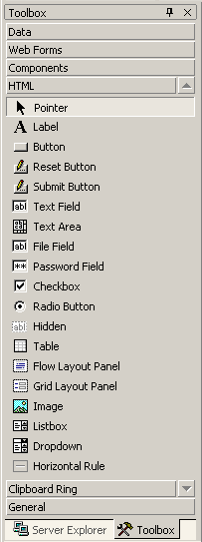
HTML Server Controls
Más livianos
Modelo de programación HTML
Menor funcionalidad
Existen en el espacio de nombres System.Web.UI.HtmlControls
Se pasan directamente al cliente
<input type="text" id="txtName” runat="server" />
Aplicaciones Web

Slide 62
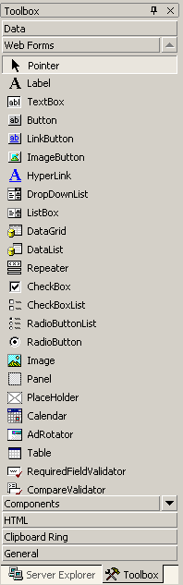
Web Server Controls
Modelo de programación orientado a objetos
Mayor funcionalidad
Más pesados
Existen en el espacio de nombres System.Web.UI.WebControls
Aplicaciones Web

Slide 63
Web Server Controls
Sintaxis del control
HTML generado por el control
<asp:TextBox id="TextBox1“ runat="server">Text_to_Display </asp:TextBox>
<input name="TextBox1" type="text” value="Text_to_Display” Id="TextBox1"/>
Aplicaciones Web

Slide 64
Controles HTML vs Controles Web
Utilizar controles de servidor HTML si: | Utilizar controles de servidor Web si:
Se prefiere un modelo de objetos como HTML | Se prefiere un modelo de programación Visual Basic o C#
Se está trabajando con páginas HTML existentes y se desea agregar funcionalidades de página ASP.NET Web | Se está escribiendo una página que puede ser utilizada por varios navegadores
El control interactuará con scripts cliente y servidor | Se necesitan funcionalidades específicas como un calendario o rotación de publicidad
El ancho de banda es limitado | El ancho de banda no es un problema
Aplicaciones Web
Notes:
Cuando cree páginas de formularios Web Forms, puede utilizar estos tipos de controles:
Controles de servidor HTML. Elementos HTML expuestos al servidor para que se puedan programar. Los controles de servidor HTML exponen un modelo de objeto que se relacionan muy estrechamente con los elementos HTML que procesan.
Controles de servidor Web. Controles con más funciones incorporadas que los controles de servidor HTML. Los controles de servidor Web incluyen no sólo controles de tipo formulario como botones y cuadros de texto, sino también controles con fines especiales como un calendario. Los controles de servidor Web son más abstractos que los controles de servidor HTML pues su modelo de objetos no refleja necesariamente la sintaxis HTML.
Controles de servidor HTML
Los controles de servidor HTML son elementos HTML que contienen atributos que los hacen visibles (y programables) en un servidor. De forma predeterminada, el servidor no tiene acceso a los elementos HTML de una página de formularios Web Forms: se tratan como texto opaco que se pasa al explorador. Sin embargo, cuando se convierten en controles de servidor HTML, los elementos HTML quedan expuestos como elementos programables en el servidor.
El modelo de objetos de los controles de servidor HTML se relaciona estrechamente con el de los elementos correspondientes. Por ejemplo, los atributos HTML se exponen en controles de servidor HTML como propiedades.
Cualquier elemento HTML de una página se puede convertir en control de servidor HTML. La conversión es un proceso simple que afecta a unos pocos atributos. Como mínimo, un elemento HTML se convierte en control agregando el atributo RUNAT="SERVER". Esto le indica al marco de trabajo de la página de ASP.NET durante el análisis que debe crear una instancia del control para su uso durante el procesamiento de la página en el servidor. Si desea hacer referencia al control como un miembro dentro del código, también deberá asignarle un atributo ID al control.
El marco de trabajo de páginas proporciona controles de servidor HTML predefinidos para los elementos HTML que se utilizan más habitualmente de forma dinámica en una página: formularios, elementos HTML <INPUT> (cuadro de texto, casilla de verificación, botón Enviar, etc.), cuadros de lista (<SELECT>), tablas, imágenes, etc. Estos controles de servidor HTML predefinidos comparten las propiedades básicas del control genérico y, además, cada control normalmente proporciona su propio conjunto de propiedades y su propio evento.
Los controles de servidor HTML ofrecen las funciones siguientes:
Un modelo de objetos que pueda volver a programar en el servidor con las técnicas habituales orientadas a objetos. Los controles de servidor exponen propiedades que permiten manipular los atributos HTML del control mediante programación en el código del servidor.
Un conjunto de eventos para los que pueda escribir controles de eventos de la misma forma que lo haría en un formulario basado en cliente, con la excepción de que un evento se controla en código del servidor.
La capacidad de controlar eventos en una secuencia de comandos de cliente.
Mantenimiento automático del estado del control. Si el formulario realiza una acción de ida y vuelta al servidor, los valores que el usuario escriba en los controles de servidor HTML se mantendrán automáticamente cuando la página se envíe de vuelta al explorador.
Interacción con controles de validación que permiten comprobar con gran facilidad si el usuario ha escrito la información adecuada en un control.
Enlace de datos a una o varias de las propiedades del control.
Compatibilidad con estilos HTML 4.0 si la página de formularios Web Forms se muestra en un explorador que admite hojas de estilos en cascada.
Paso a través de atributos personalizados. Pueden agregarse los atributos que se necesiten a un control de servidor HTML: el marco de trabajo de páginas los leerá y los procesará sin ningún cambio en la funcionalidad. Esto permite agregar atributos específicos del explorador a los controles.
Controles de servidor Web
Los controles de servidor Web son un segundo conjunto de controles diseñado con otro enfoque. No se asignan uno a uno a controles de servidor HTML. En lugar de ello, se definen como controles abstractos, en los que el HTML real procesado por el control puede ser muy diferente al modelo con respecto al que se han programado. Por ejemplo, un control RadioButtonList de servidor Web podría procesarse en una tabla o como un texto en línea con otro HTML.
Los controles de servidor Web incluyen controles de formulario tradicionales como botones y cuadros de texto, además de controles complejos, como, por ejemplo, las tablas. También incluyen controles que proporcionan funcionalidad de formulario de uso frecuente, como la presentación datos en cuadrícula, la elección de fechas, etc.
Los controles de servidor Web ofrecen todas las funciones descritas anteriormente para los controles de servidor HTML (excepto la asignación uno a uno a elementos HTML) y estas funciones adicionales:
Un modelo de objetos enriquecido que proporciona capacidades de programación de tipo seguro.
Detección automática del explorador. Los controles pueden detectar capacidades del explorador y crear el resultado apropiado para exploradores básicos y enriquecidos (HTML 4.0).
Para algunos controles, la capacidad de definir su propia apariencia para el control mediante plantillas.
Para algunos controles, la capacidad de especificar si un evento del control provoca un envío inmediato al servidor o, en su lugar, se almacena en caché y se activa cuando se envía el formulario.
Capacidad para pasar eventos de un control anidado (como un botón en una tabla) al control contenedor.
Cuando la vista HTML está en tiempo de diseño, los controles aparecen en la página con un formato como el siguiente:
<asp:button attributes runat="server"/>
En este caso los atributos no son los de los elementos HTML. En lugar de ello, son propiedades del control Web.
Cuando se ejecuta la página de formularios Web Forms, el control de servidor Web se procesa en la página utilizando el HTML apropiado, que con frecuencia no sólo depende del tipo de explorador sino también de la configuración que haya realizado para el control. Por ejemplo, un control TextBox podría procesarse como una etiqueta <INPUT> o una etiqueta <TEXTAREA>, dependiendo de sus propiedades.
HTML vs. Server Controls
HTML (HTMLControls)
Más livianos
Modelo de programación HTML
Menor funcionalidad
Server Controls (WebControls)
Modelo de programación orientado a objetos
Mayor funcionalidad
Más pesados

Slide 65
User Controls
User Controls simplifica la reutilización del código y los componentes de la UI con una aplicación Web
Un User Control es un control Web server definido por el usuario con extensión .ascx
Contiene HTML, pero no el <HTML>, <BODY>, o las etiquetas <FORM>
Contiene código para administrar sus propios eventos
<%@ Control Language="vb" %>
<%@ Control Language="c#" %>
Aplicaciones Web
Notes:
Debido a que los user control pueden simplificar la reutilización del código y de componentes comunes UI, entender que son y como trabajan es muy importante. Los user controls son paginas ASP.NET con extensión ascx. Similar a las paginas Web Forms, usted puede editar estos controles con cualquier editor de texto o desarrollarlo usando code-behind clases. También, de manera similar a las paginas Web Forms, user controls son compilados cuando son pedidos por primera vez, y almacenados en memoria del servidor para reducir el tiempo de respuesta para peticiones sucesivas. A diferencia de la paginas Web Forms, los user control no pueden ser peticionados independientemente, deben ser incluidos en Web Forms para poder funcionar

Slide 66
User Controls
Similar a una página Web Form completa
Tiene una página de interfaz de usuario y un archivo de código subyacente
  Directiva @Control
  Extensión .ascx
  No tiene elementos <HTML>, <BODY> y <FORM>
  Contiene código para manejar sus propios eventos
Hay dos maneras de crear un Control de Usuario:
  Crear un nuevo Control de Usuario
  Convertir una página ASP.NET existente a un Control de Usuario
Aplicaciones Web
Notes:
Agregar controles de usuario a una página de formularios Web Forms
Para agregar controles de usuario Web a páginas de formularios Web Forms en la vista Diseño sencillamente arrastre el control desde el Explorador de soluciones y colóquelo en el lugar de la página donde desee que aparezca. El Diseñador de Web Forms agrega automáticamente a la página una directiva @ Register y una etiqueta para el control. A partir de este punto, los controles se convierten en parte de las páginas y aparecen representados cuando éstas se procesan. Asimismo, los eventos, propiedades y métodos públicos del control se exponen a la página pueden manipularse mediante programación. También pueden agregarse controles de usuario a una página mediante programación
Nota El control de usuario debe estar en el mismo proyecto que la página de formularios Web Forms. Para agregar un control de usuario a una página de formularios Web Forms
En el Diseñador de Web Forms, abra la página a la que desee agregar el control y asegúrese de que la página está en la vista Diseño.
En el Explorador de soluciones, seleccione el archivo del control de usuario y arrástrelo a la página.
Para agregar un control de usuario a una página de formularios Web Forms en la vista HTML
En el diseñador de formularios Web Forms, abra la página a la que desee agregar el control y, a continuación, cambie a la vista HTML.
En la parte superior de la página, antes de la etiqueta <HTML>, agregue una directiva que registre el control de forma que sea reconocido cuando ésta se procese. Esta directiva se usa para asociar un nombre y un espacio de nombres con el control de usuario Web especificando los valores de ubicación TagPrefix, TagName y Src. Por ejemplo:
<%@ Register TagPrefix="uc1" TagName="menu" Src="menu.ascx" %>
Sitúe la directiva en su propia línea. Si no hay más directivas, haga que ésta sea la primera línea del archivo.
En la parte <BODY> del archivo, cree una etiqueta para el control en la ubicación en la que desee que éste aparezca. Utilice los valores TagPrefix y TagName que registró en el paso 2. Asigne una identificación (id.) al control y establezca el atributo runat=server, como en el ejemplo siguiente:
<uc1:menu id="Menu1" runat="server"/>
Si el control tiene propiedades que se puedan establecer en tiempo de diseño, y así lo desea, establézcalas declarando sus valores en la etiqueta:
<uc1:menu id="Menu1" runat="server" enabled=true />
Siga diseñando el resto de la página de formularios Web Forms. Si le resulta más cómodo, cambie a la vista Diseño para trabajar con la página. En ella, se mostrará el control de usuario mediante un glifo que indica su localización, pero no se mostrará una representación WYSIWYG en el diseñador. Para editar el control, vuelva a la vista HTML.

Slide 67
User Controls
Registre el control de usuario al comienzo de la página del Web Formscontenedor con la directiva @Reference2.
Cree una instancia del control de usuario, ya sea en el archivo de la clase del código subyacente o en el bloque de declaración de código del archivo contenedor .aspx
  <%@ ReferenceControl=“myUserControl.ascx" %>
  Control userControl1= LoadControl(“myUserControl.ascx");
  ((myUserControl)userControl1).Color = “red";
  Page.Controls.Add(userControl1);
Aplicaciones Web

Slide 68
Laboratorio
Creación de un Web Form user control
Notes:
Para agregar un control de usuarios, primero debemos ingresar a un proyecto nuevo o uno existente.
Sobre el Menu Project, clic en Add Web User Control.
Agregue el texto y los controles que sean necesarios. Cualquier control que usted quiera que este disponible para acceder desde programación debería ser un control Web Forms o HTML Server
Use el Web Form Designer para configurar propiedades y crear el código necesario para su control.

Slide 69
Laboratorio
Agregar user control a Web Forms
Notes:
Agregar controles de usuario a una página de formularios Web Forms
Para agregar controles de usuario Web a páginas de formularios Web Forms en la vista Diseño sencillamente arrastre el control desde el Explorador de soluciones y colóquelo en el lugar de la página donde desee que aparezca. El Diseñador de Web Forms agrega automáticamente a la página una directiva @ Register y una etiqueta para el control. A partir de este punto, los controles se convierten en parte de las páginas y aparecen representados cuando éstas se procesan. Asimismo, los eventos, propiedades y métodos públicos del control se exponen a la página pueden manipularse mediante programación. También pueden agregarse controles de usuario a una página mediante programación
Nota El control de usuario debe estar en el mismo proyecto que la página de formularios Web Forms. Para agregar un control de usuario a una página de formularios Web Forms
En el Diseñador de Web Forms, abra la página a la que desee agregar el control y asegúrese de que la página está en la vista Diseño.
En el Explorador de soluciones, seleccione el archivo del control de usuario y arrástrelo a la página.
Para agregar un control de usuario a una página de formularios Web Forms en la vista HTML
En el diseñador de formularios Web Forms, abra la página a la que desee agregar el control y, a continuación, cambie a la vista HTML.
En la parte superior de la página, antes de la etiqueta <HTML>, agregue una directiva que registre el control de forma que sea reconocido cuando ésta se procese. Esta directiva se usa para asociar un nombre y un espacio de nombres con el control de usuario Web especificando los valores de ubicación TagPrefix, TagName y Src. Por ejemplo:
<%@ Register TagPrefix="uc1" TagName="menu" Src="menu.ascx" %>
Sitúe la directiva en su propia línea. Si no hay más directivas, haga que ésta sea la primera línea del archivo.
En la parte <BODY> del archivo, cree una etiqueta para el control en la ubicación en la que desee que éste aparezca. Utilice los valores TagPrefix y TagName que registró en el paso 2. Asigne una identificación (id.) al control y establezca el atributo runat=server, como en el ejemplo siguiente:
<uc1:menu id="Menu1" runat="server"/>
Si el control tiene propiedades que se puedan establecer en tiempo de diseño, y así lo desea, establézcalas declarando sus valores en la etiqueta:
<uc1:menu id="Menu1" runat="server" enabled=true />
Siga diseñando el resto de la página de formularios Web Forms. Si le resulta más cómodo, cambie a la vista Diseño para trabajar con la página. En ella, se mostrará el control de usuario mediante un glifo que indica su localización, pero no se mostrará una representación WYSIWYG en el diseñador. Para editar el control, vuelva a la vista HTML.

Slide 70
Web Custom Controls
Los controles pueden ser reutilizables
Se pueden generar nuevos controles
Diferentes formas de crear Custom Controls
  Compilar un control que combine la funcionalidad de dos o más controles existentes
  Personalizar un Control existente derivando de este y reemplazando (overriding) sus características
  Crear un control personalizado al derivar de la clase base Control
Aplicaciones Web

Slide 71
Web Custom Controls
Se compila y se guarda en un ensamble
Se puede usar en múltiples aplicaciones
Se puede agregar al Cuadro de Herramientas
Caching por programación
Aplicaciones Web

Slide 72
Web Custom Controls
Implementan estas interfaces básicas
  IAttributeAccessor
  IComponent
  IParserAccessor
Se puede heredar de todos los controles del web del Framework y extenderlos
Pueden almacenar el estado en ViewState
Aplicaciones Web

Slide 73
Web Custom Controls
Ciclo de Vida
  Init
  LoadViewState
  ProcessPostData
  Load
  ProcessPostData
  RaiseChangeEvents
  RaisePostBackEvent
  PreRender
  SaveViewState
  Render
  Dispose
  Unload
Aplicaciones Web

Slide 74
User Controls vs Web Custom Controls
User Controls | Web Custom Controls
Más fáciles de crear | Más difíciles de crear
Compatibilidad limitada para los usuarios que usan herramientas de diseño visual | Total compatibilidad con todas las herramientas de diseño visual
Es necesaria una copia independiente del control para cada aplicación | Sólo es necesaria una copia del control, ubicada en la caché del ensamblado global
No pueden ser agregados al Cuadro de Herramientas de Visual Studio | Pueden ser agregados al Cuadro de Herramientas de Visual Studio
Buenos para contenidos estáticos | Buenos para contenidos dinámicos
Se puede utilizar Visual Studio para diseñar el control | No existe un diseñador, debe escribirse por código
Aplicaciones Web
Notes:
Los controles Web personalizados son componentes compilados que se ejecutan en el servidor, y que encapsulan la interfaz de usuario y el resto de la funcionalidad relacionada en paquetes reutilizables. Pueden incluir todas las funciones de tiempo de diseño de los controles de servidor ASP.NET estándar, incluida la total compatibilidad con las funciones de diseño de Visual Studio, como la ventana Propiedades, el diseñador visual y el Cuadro de herramientas.
Hay varias formas de crear controles Web personalizados:
Se puede compilar un control que combine la funcionalidad de dos o más controles existentes. Por ejemplo, si se necesita un control que encapsule un botón y un cuadro de texto, se puede crear compilando los controles existentes en uno. Para obtener más información, vea Desarrollar un control compuesto.
Si un control de servidor existente casi reúne los requisitos pero le faltan algunas funciones, se puede personalizar creando un derivado suyo y sobrescribiendo sus propiedades, métodos y eventos.
Si ninguno de los controles de servidor Web existente (ni sus combinaciones) cumplen los requisitos necesarios, se puede crear un control personalizado derivado de una de las clases de controles básicas. Estas clases proporcionan toda la funcionalidad básica de los controles de servidor Web para que el usuario se pueda concentrar en programar las funciones necesarias.
Nota de seguridad: En Visual Studio, en tiempo de diseño, el código siempre se ejecuta con plena confianza, aunque pueda incluirse finalmente en un proyecto donde quizá no reciba una confianza tan plena durante la ejecución. Es decir, un control personalizado podría funcionar perfectamente durante las pruebas en el equipo del programador, pero podría dar errores a causa de la falta de los permisos adecuados en una aplicación implementada. Compruebe siempre los controles en el contexto de seguridad donde se ejecutarán en las aplicaciones reales.

Slide 75
Mas Información
Ampliar en materiales y bibliografía sugerida

Slide 76
Resumen
Web Project System
Interfaz de Usuario (UI)
  Master Pages.
  Themes & Skins.
Acceso a datos y Databinding.

